Slide 1

TO DO LIST WEB DEVELOPMENT PROJECT
Muskan Bansal

Slide 2
Contents
Motivation of project
Introduction
Technologies used in project
Design of project

Slide 3
Motivation of project
One of most important reason you should use to do list is that it will help you stay organized.
When you write all your tasks in a list they seem more manageable.
It helps to manage our time in efficient manner.

Slide 4
Introduction
To do list is a to-do-list and tasks manager for professionals, students and small business combining tasks, projects, comments, attachments, notification and more.
To do list lets users streamline their personal and team productivity efficiently.

Slide 5
Technologies used in project
For Frontend
HTML : HTML stands for Hyper Text Markup Language. HTML as the language used for creating detailed instructions concerning style, type, format, structure and the makeup of a web page before it gets printed.
CSS :CSS stands for Cascading Style Sheets. CSS is a design language that you use to make your web page look nice and presentable.
JAVASCRPIT: JavaScript is the programming language, used to control the behavior of different elements.

Slide 6
For Server side or Backend
NODEJS : NodeJS is primarily used for non-blocking, event-driven servers, due to its single-threaded nature. It's used for traditional web sites and back-end API services.
EXPRESSJS :Express.js is a Node.js web application server framework, designed for building single-page, multi-page, and hybrid web applications.
EJS : An EJS file contains code written in the Embedded JavaScript (EJS) templating language, which is utilized to generate HTML markup using JavaScript.

Slide 7
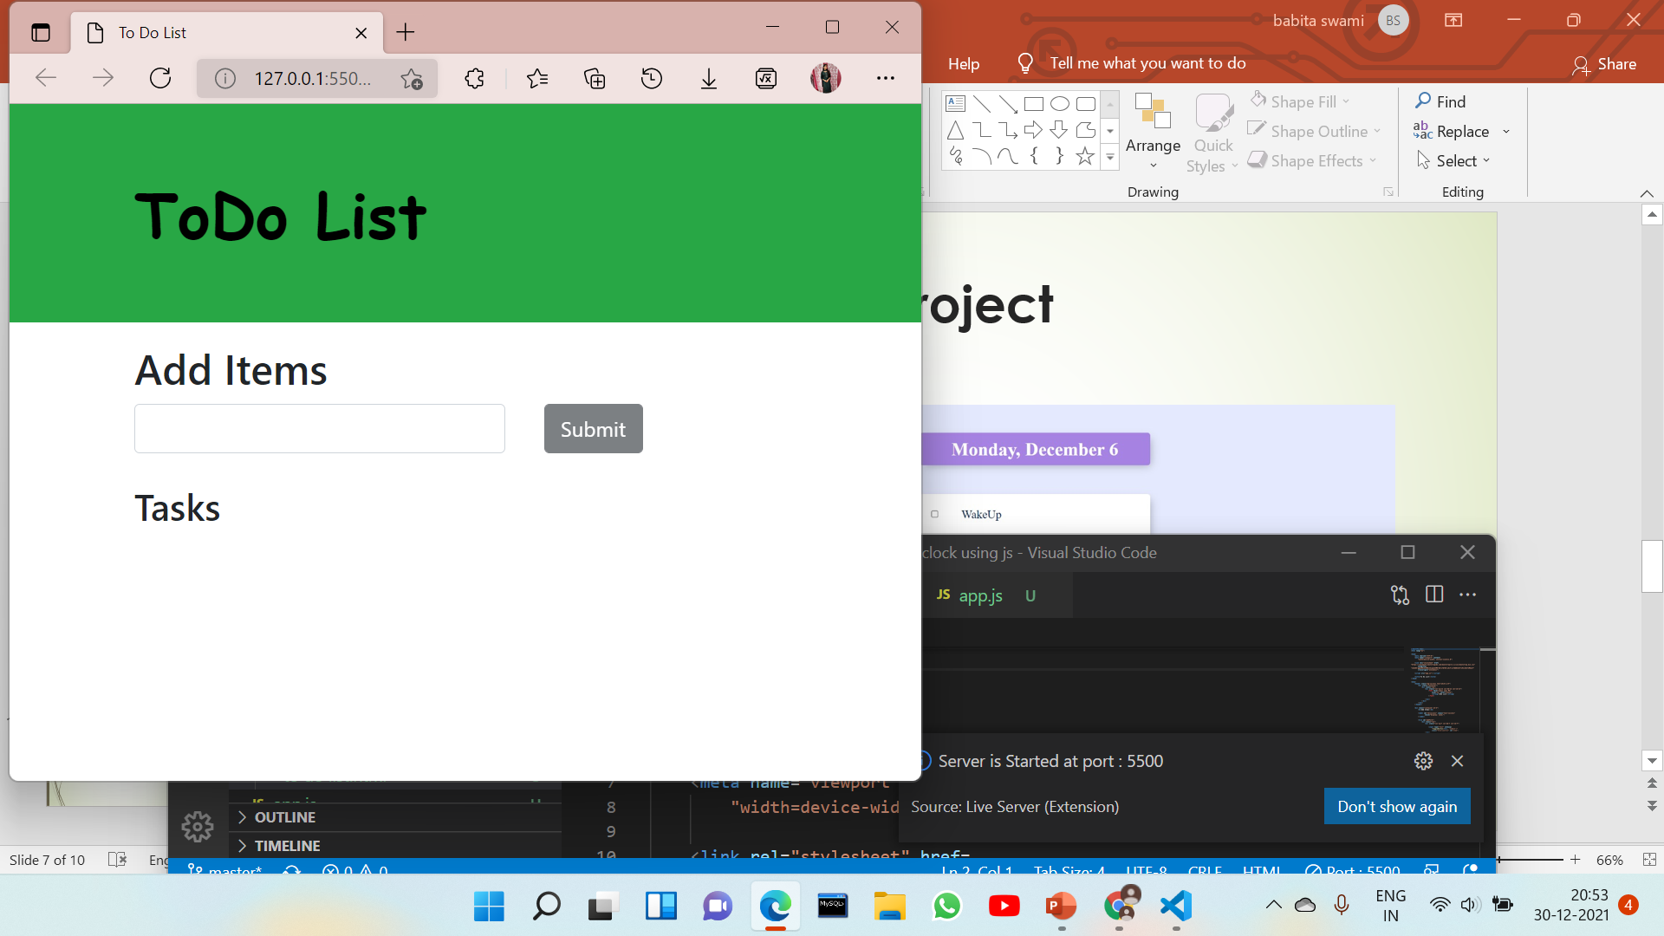
Design of project

Slide 8
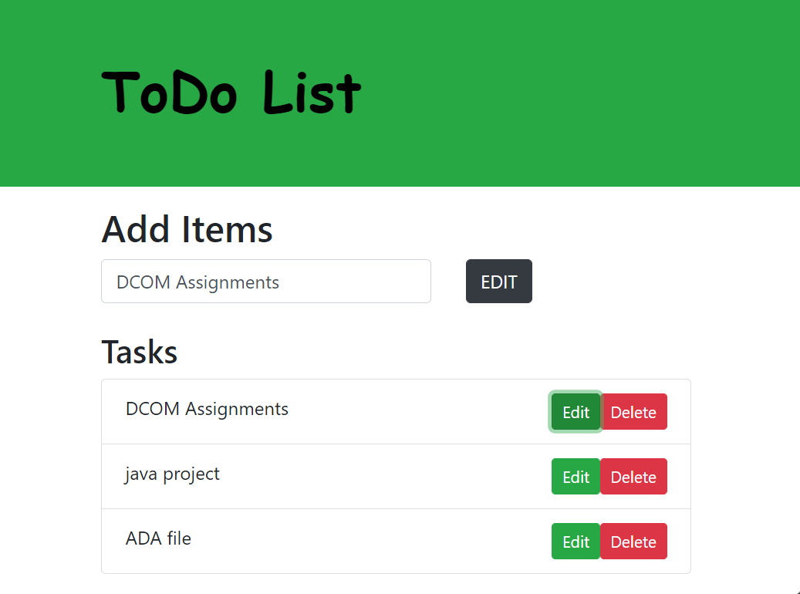

Slide 9
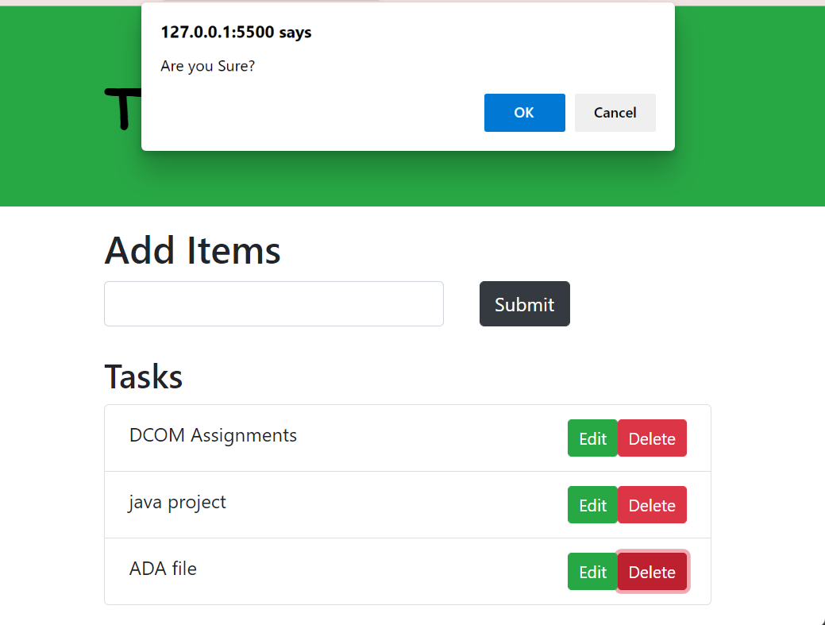

Slide 10
THANK YOU

